Slide 1
IBM University Engagement Project Submission
“Exploring the Power of Agentic AI with IBM Granite and LangFlow”

Slide 2

Project Tile - MentalGuard: An Agentic AI for Mental Health Awareness & Suicide Prevention
Domain of Project - Healthcare
Student Name | Recent Passport Photo | Email ID | Mobile number [WhatsApp]
Mansi Suhas Jagtap |  | mansij287@gmail.com | 9096660304

Slide 3
Problem Statement - Agentic AI for Mental Health Awareness & Suicide Prevention
Problem Statement – MindGuard
Mental health issues such as stress, anxiety, depression, and suicidal thoughts often go unnoticed due to social stigma, lack of awareness, and limited access to timely support. Many individuals hesitate to seek professional help or may not recognize the early signs of emotional distress.
The objective is to build an AI-powered Mental Health Assistant that provides emotional support, identifies potential mental health risks, and promotes early intervention.
Emotion Detection (RAG):
Analyze user conversations and emotional patterns.
Retrieve relevant mental health resources and coping strategies.
Sentiment Analysis:
Detect signs of stress, anxiety, depression, and emotional distress.
Risk Assessment:
Identify users who may be at risk and recommend appropriate support.
Multi-Agent System:
Emotion Detection Agent
Sentiment Analysis Agent
Risk Assessment Agent
Wellness Recommendation Agent
Visualization Dashboard:
Display mood trends, wellness insights, and support recommendations.
Tech Stack: IBM LangFlow, IBM Granite Models, Watsonx.ai

Slide 4
Proposed Solution -
Proposed Solution – MindGuard
MentalGuard is an Agentic AI system designed to act as a compassionate digital companion.
Data Processing: Analyze user inputs and emotional indicators.
Emotion Detection Agent: Identifies emotions from conversations.
Sentiment Analysis Agent: Determines stress and anxiety levels.
Risk Assessment Agent: Detects patterns associated with depression and suicidal ideation.
Wellness Recommendation Agent: Suggests mindfulness exercises, coping strategies, and self-care practices.
Support Guidance: Encourages users to contact professionals or trusted individuals during critical situations.
Continuous Learning: Improves support quality based on user interactions while maintaining privacy.

Slide 5
Technology Used
LangFlow Platform – Designing and orchestrating multi-agent workflows.
IBM Granite Model (Granite-4.0-8B-Instruct) – Natural language understanding and empathetic responses.
IBM Cloud – Secure deployment and scalability.
RAG (Retrieval-Augmented Generation) – Fetches mental health resources and support information.
IBM Watsonx.ai – Model deployment and AI governance.
Vector Database (FAISS/Chroma) – Stores wellness resources, crisis support information, and conversation embeddings.

Slide 6
Langflow component Used -
Chat Input
Users share thoughts, emotions, or concerns.
IBM Watsonx AI Agent
Processes user emotions and generates supportive responses.
IBM Granite Model
Granite-4.0-8B-Instruct for empathetic and contextual interactions.
Chat Output
Displays emotional insights, wellness tips, and recommendations.
File Component
Stores mental health resources and educational materials.
Data Processing Component
Performs sentiment analysis and emotional classification.

Slide 7
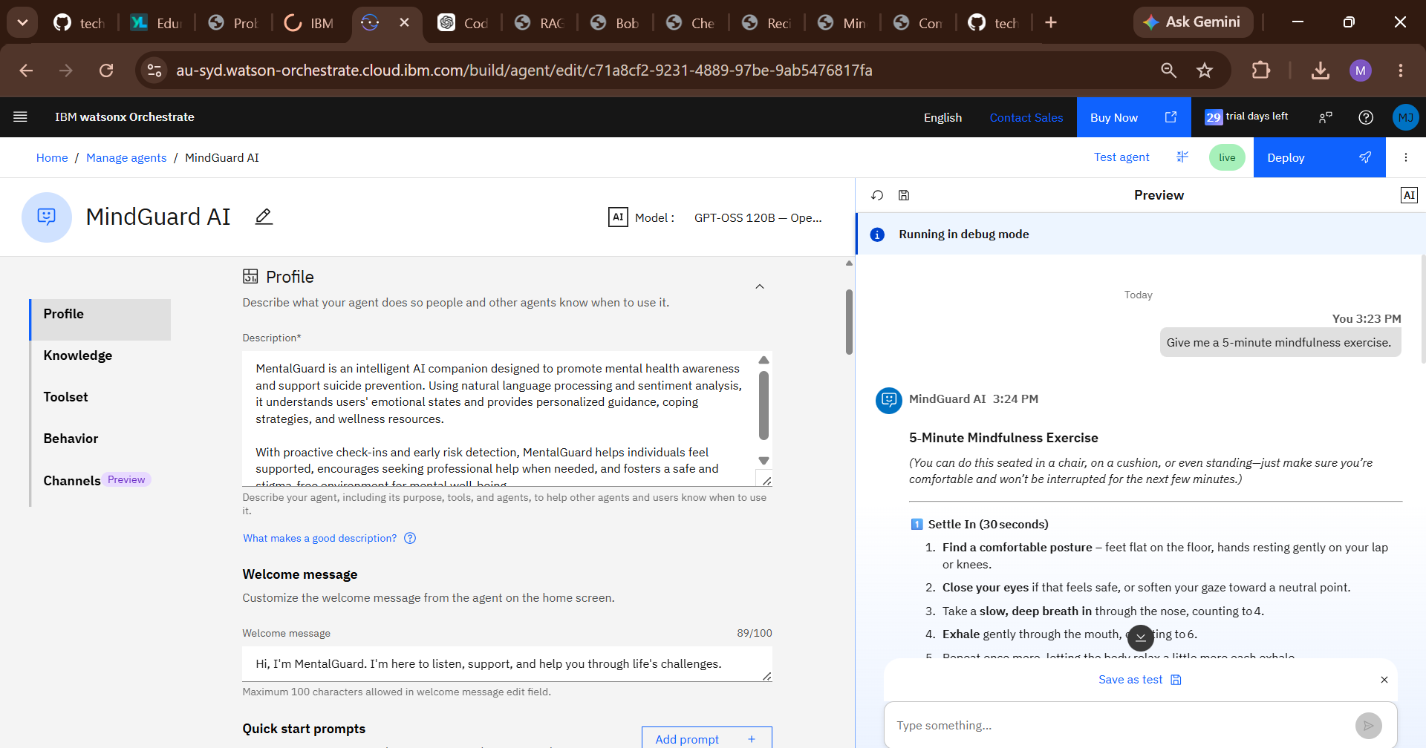
Langflow workflow -

Slide 8
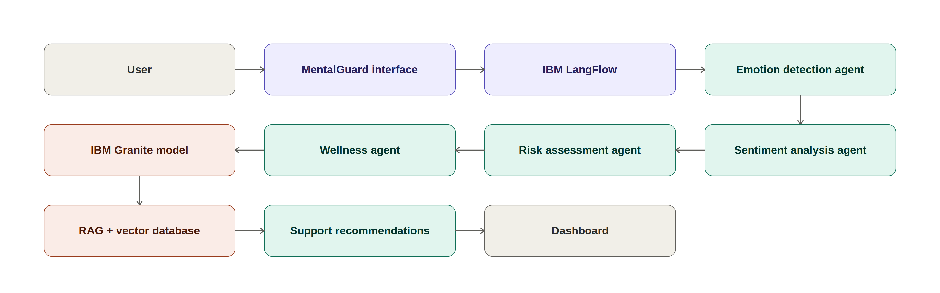
Architecture blueprint

Slide 9
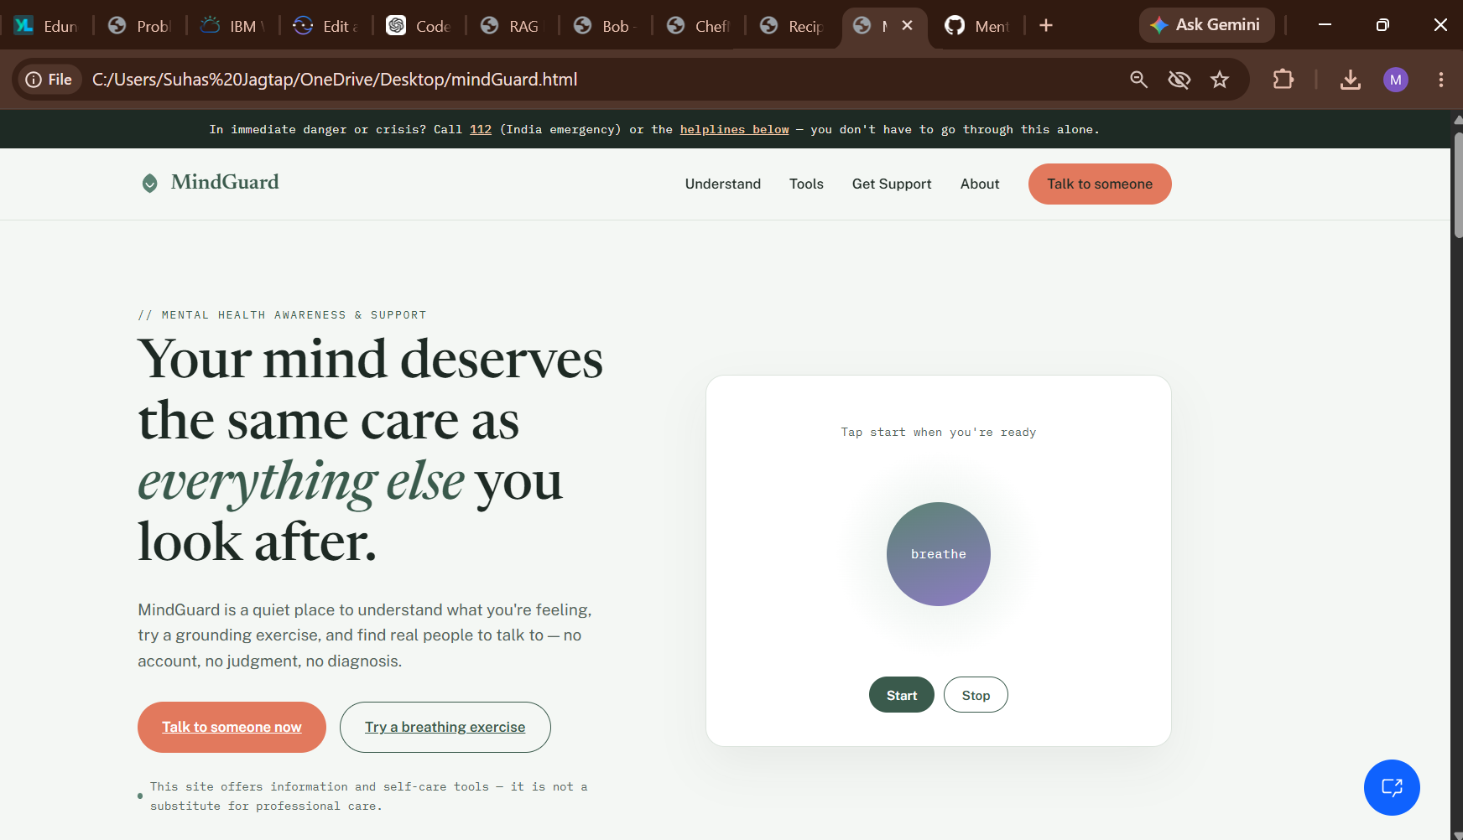
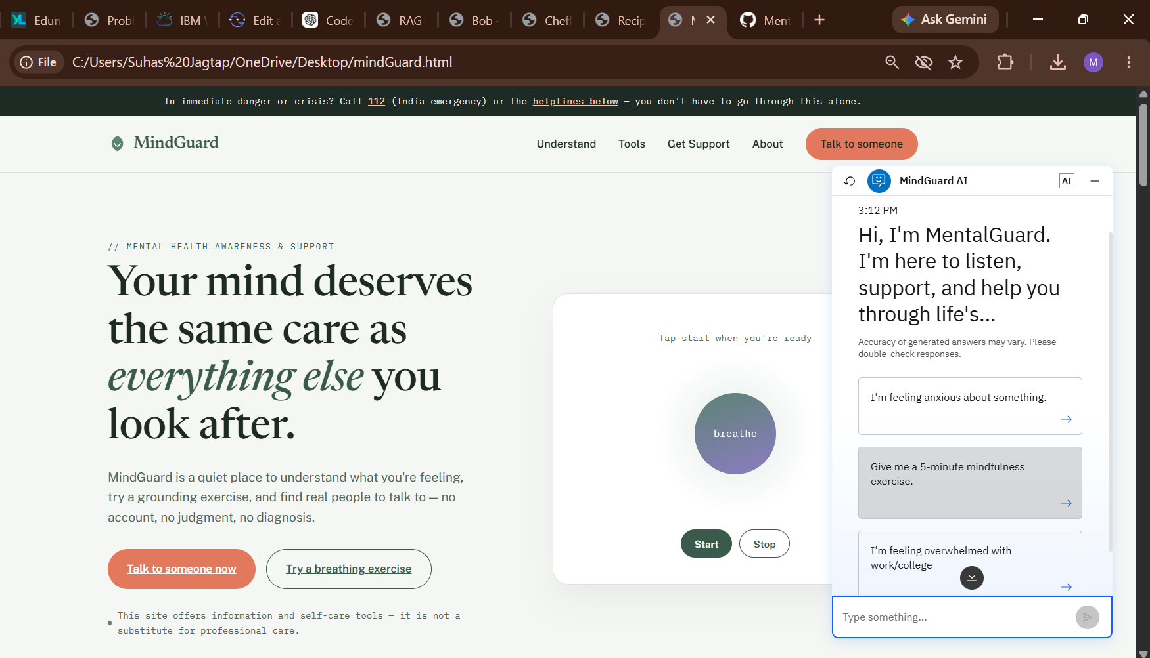
MindGuard User Interface

Slide 10

Role of Agentic AI in the solution
Role of Agentic AI in MindGuard
IBM Watsonx.ai hosts the Granite foundation model, which serves as the core Agentic AI engine for MentalGuard. The system autonomously receives user inputs, analyzes emotional patterns, retrieves relevant mental health resources, and orchestrates multiple AI agents to provide personalized support.
Using Granite's reasoning capabilities, MentalGuard delivers empathetic conversations, wellness recommendations, and early risk detection while encouraging professional intervention during critical situations. The platform aims to create a safe and accessible environment where users feel heard, supported, and empowered.
.

Slide 11
Novelty and Uniqueness
Agentic AI-powered mental health assistant using IBM Granite.
Multi-agent architecture for emotion detection and risk assessment.
Retrieval-Augmented Generation (RAG) for accurate wellness recommendations.
Explainable AI providing emotional insights and coping strategies. Proactive wellness check-ins and mood tracking.
Secure and privacy-focused design.
Scalable architecture for web and mobile applications.
Promotes mental health awareness and suicide prevention.

Slide 12
Git Hub Link
Github URL – https://github.com/techytap/MindGuard-Agentic-AI
·
·
·

Slide 13
Future Scope
Integrate voice-based emotional analysis.
Add multilingual support.
Develop a mobile application.
Integrate wearable devices for stress monitoring.
Implement personalized wellness plans.
Support therapists with AI-assisted reports.
Add real-time crisis alerts.
Expand to educational institutions and workplaces.
·
·
·

Slide 14
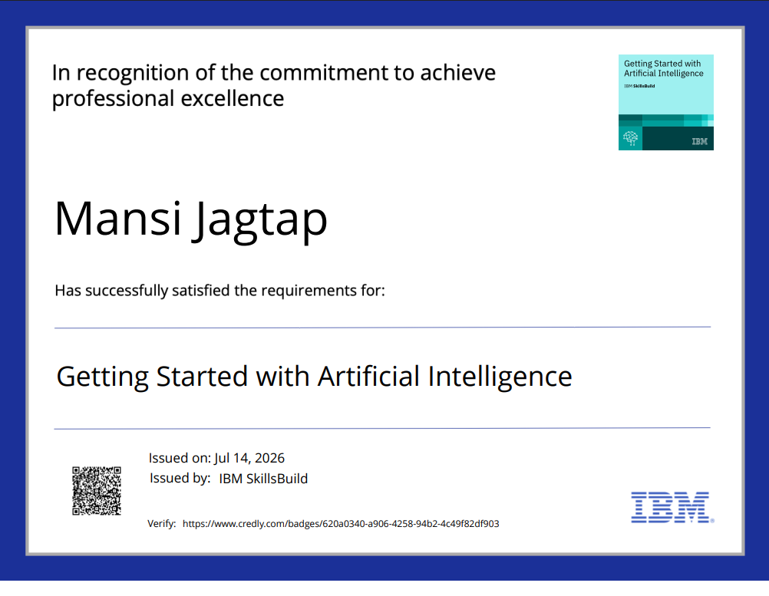
Certificates Earned:

Slide 15
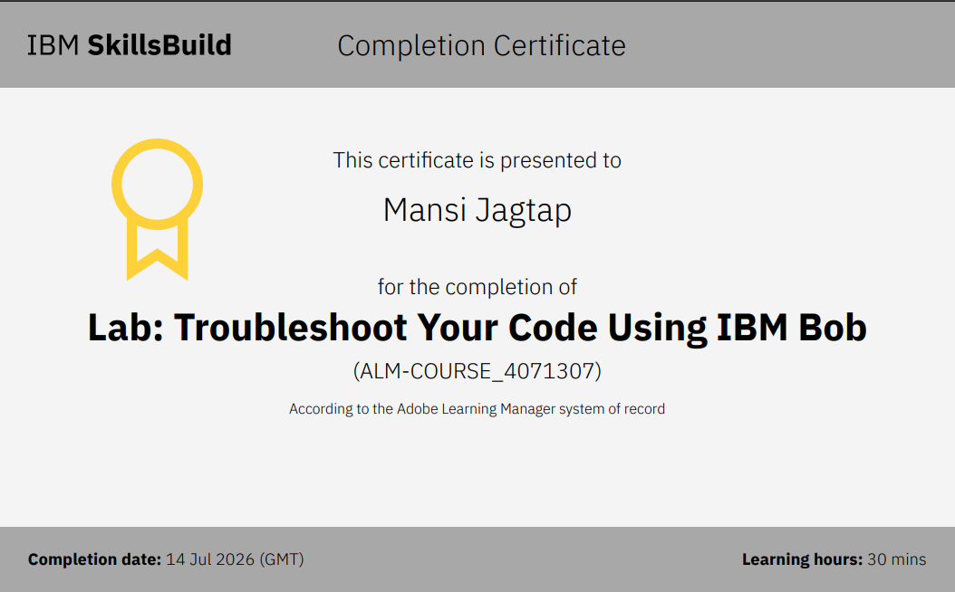
Certificates Earned:​

Slide 16
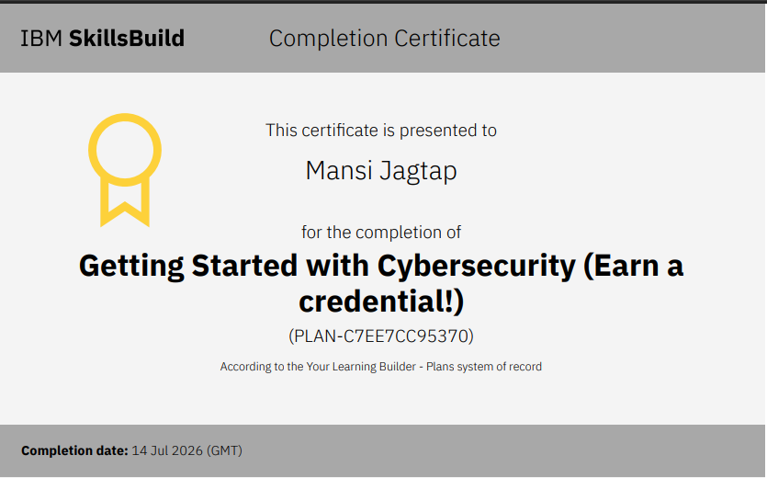
Certificates Earned:​

Slide 17


